Slide 1
Life and Death in America: How to be Smart Health Care Consumer
Adam D. Marks, MD MPH
Assistant Professor of Medicine
University of Michigan Health System
Notes:
Good afternoon everyone, and thank you for having me. My name is Adam Marks, I’m a physician at the University of Michigan hospital. I am certified to practice pediatrics, internal medicine as well as palliative and hospice medicine. Today I’ll be talking about how we live and die in America, and introduce you to the concepts of palliative care as well as hospice medicine.
Now, before I get started, I’d like to do an informal survey.
How many of you have had a loved one die, such as a close friend or family member?
How many of you have had a loved one enrolled in hospice?
How many of you have had the opportunity to care for a loved one who was approaching the end of life?

Slide 2

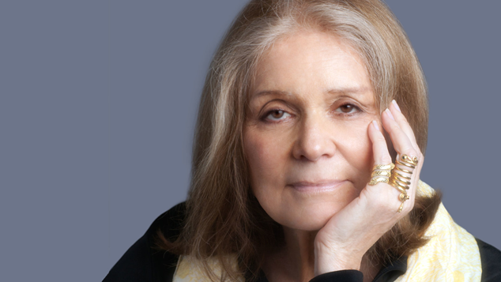
“The truth will set you free
but first it will piss you off”
- Gloria Steinem
Notes:
One of my favorite quotes is from Gloria Steinem, an american author and activist.
I show you this quote because this is how I hope you’ll walk away from this talk. Knowledge and education should, on some level, challenge us to action, to change the world around us for the better. I hope to present you with facts about how Americans live and die and show how, for many people, the medical system currently in place is failing us; that we are dying deaths we deplore in places we despise; and that much of the medical care that we receive in the final days of life is not only unwanted but of little or no benefit. I hope that the information I provide to you will galvinize you learn more and to advocate for patient education, autonomy, and increased communication about a very difficult topic, namely death.

Slide 3
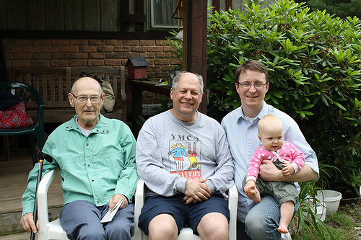
How We Live in America
Notes:
America has been a driver of medical innovation and has, for the most part, reaped the beneifts of modern medical advances. You may have heard that we lag behind many industrialized nations in terms of longevity and overall health, but I’m not here to talk about that. In general, people are living longer and living better. To illustrate this point, I show you a picture.
This picture was taken two years ago at my grandfather’s 90th birthday party. Like me, my father and grandfather are physicians. The infant is my daughter. Like me, they have all benefited from modern medicine.
When I was born, I was breech which means that rather than coming out head first, I tried to come out feet first. This is a dangerous complication of delivery, and prior to the invention of the C/S, was a leading cause of death around the time of delivery. My mother was rushed for emergency C/S, and we both survived the episode without any lasting ill effects. Without that intervention, we both had a high risk of death.
My father, a pediatrician, was diagnosed with colon cancer at the age of 61, when it was caught on a routine colonoscopy. It was caught early, and he underwent surgical resection. He is four years out now, and cancer free. He continues to work, teach, and otherwise be active. Even a few decades ago, it is unlikely his cancer would have been caught at such an early stage, when his risk of death would have been much greater.
My grandfather, a WWII vet and father of six, worked as a general pracitioner in upstate NY for over 50 years before finally retiring at the age of 82. At 93 years old, he has diabetes, kidney damage, dementia, and coronary artery disease. With the help of modern medicine, including medication and in implanted pacemaker, he remains independent, living in the house where my father was raised, and able to enjoy his children, grandchildren, and great-grandchildren.
Finally, my daughter. One month after this picture was taken, she was diagnosed with a serious pneumonia that required a brief hospitalization, IV antibiotics and oxygen support. While she recovered quickly, without those interventions she could very well have had serious complications or even have died before the age of 1.
I show you this picture and say these things to remind you of the amazing, miraculous and priceless advances that modern, western medicine has made. I’ll wager that everyone in this room has either themselves or have had a loved one who has directly benefited from aggressive medical intervention. I’ll spend a lot of time talking about some problems with healthcare in the United States, but please don’t loose site of the fact that medicine saves lives in a very real sense, and allows people to live happy, healthy and productive lives in a way that a few generations ago would have been unimaginable.

Slide 4
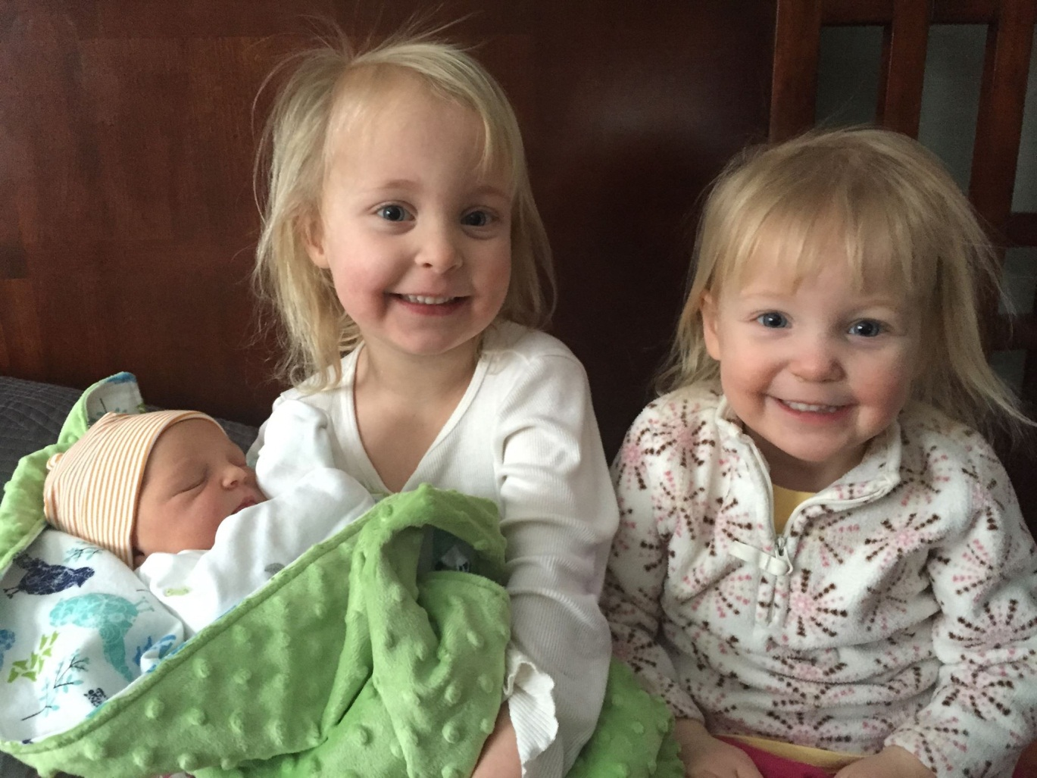
How We Live in America
Notes:
America has been a driver of medical innovation and has, for the most part, reaped the beneifts of modern medical advances. You may have heard that we lag behind many industrialized nations in terms of longevity and overall health, but I’m not here to talk about that. In general, people are living longer and living better. To illustrate this point, I show you a picture.
This picture was taken two years ago at my grandfather’s 90th birthday party. Like me, my father and grandfather are physicians. The infant is my daughter. Like me, they have all benefited from modern medicine.
When I was born, I was breech which means that rather than coming out head first, I tried to come out feet first. This is a dangerous complication of delivery, and prior to the invention of the C/S, was a leading cause of death around the time of delivery. My mother was rushed for emergency C/S, and we both survived the episode without any lasting ill effects. Without that intervention, we both had a high risk of death.
My father, a pediatrician, was diagnosed with colon cancer at the age of 61, when it was caught on a routine colonoscopy. It was caught early, and he underwent surgical resection. He is four years out now, and cancer free. He continues to work, teach, and otherwise be active. Even a few decades ago, it is unlikely his cancer would have been caught at such an early stage, when his risk of death would have been much greater.
My grandfather, a WWII vet and father of six, worked as a general pracitioner in upstate NY for over 50 years before finally retiring at the age of 82. At 93 years old, he has diabetes, kidney damage, dementia, and coronary artery disease. With the help of modern medicine, including medication and in implanted pacemaker, he remains independent, living in the house where my father was raised, and able to enjoy his children, grandchildren, and great-grandchildren.
Finally, my daughter. One month after this picture was taken, she was diagnosed with a serious pneumonia that required a brief hospitalization, IV antibiotics and oxygen support. While she recovered quickly, without those interventions she could very well have had serious complications or even have died before the age of 1.
I show you this picture and say these things to remind you of the amazing, miraculous and priceless advances that modern, western medicine has made. I’ll wager that everyone in this room has either themselves or have had a loved one who has directly benefited from aggressive medical intervention. I’ll spend a lot of time talking about some problems with healthcare in the United States, but please don’t loose site of the fact that medicine saves lives in a very real sense, and allows people to live happy, healthy and productive lives in a way that a few generations ago would have been unimaginable.

Slide 5
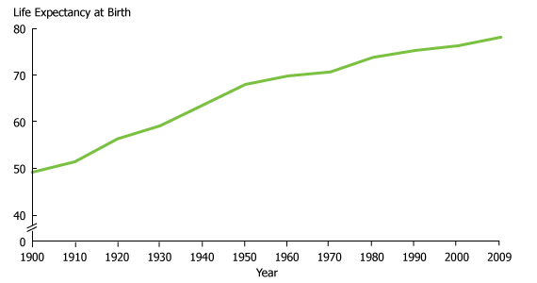
Living in America: Living Longer
Life expectancy is up dramatically in the past 100 years
Notes:
In 1900, the average life expectancy was 48. In 2009, it was 78. We have, on average, gained THREE DECADES of life. It is hard to grasp.

Slide 6
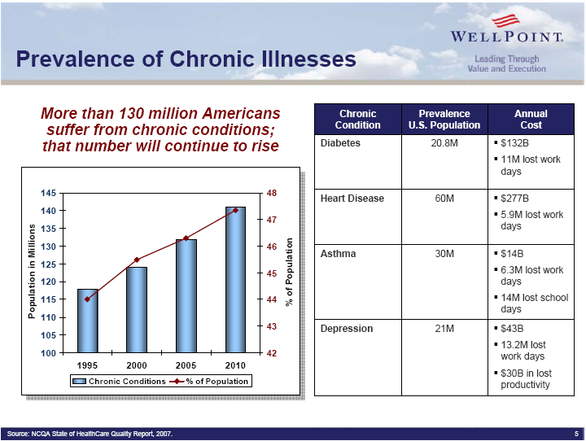
Living in America: Living with Disease
Not only are we living longer, the number of people living with chronic diseases are going up.
Notes:
In the instances where we can’t cure disease, we are learning how to live WITH disease. Again, I refer you back to my grandfather, who is living with multiple chronic diseases any one of which would have ended his life prematurely before modern medical advances. Insulin, pacemakers, heart medications, dialysis, even HIV/AIDs; what were once terminal diseases have largely become chronic disease, that is, disease that can be controlled and managed for many years.
As medical advances continue, and as our population continues to age, we can expect that not only will more people live with chronic disease, but more people, like my grandfather, will live with MULTIPLE chronic disease.

Slide 7
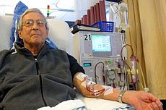
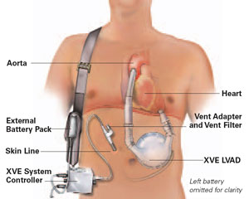
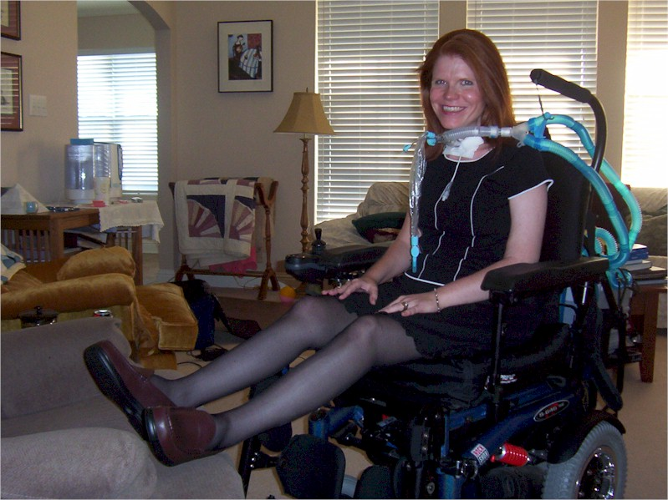

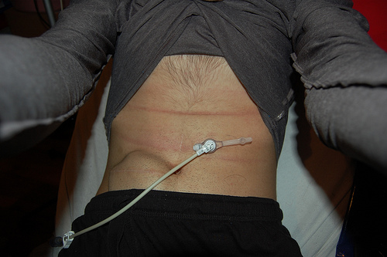
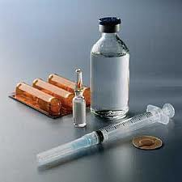
Living in America: Living with Disease
Notes:
Dialysis – every year almost 100,000 Americans start dialysis, which replaces the function of the kidneys with a dialysis machine. Many people survive years on dialysis, and with this are able to live active, comfortable lives.
LVAD- if you’re familiar with Dick Cheney, you may know that he had one of these, which is a mechanical device implanted to help the heart function more efficiently. People again can live years with this device in place, who otherwise would most likely die from heart failure.
In addition to these, there are literally dozens of other devices and advancements that have turned deadly diseases into chronic diseases, such as insulin, feeding tubes, ventilators and anti-retroviral therapies for AIDS. Again, I say this to high-light the incredible successes of the medical field in turning deadly diseases into diseases that not only people can live with, but can live productive, high-quality lives.

Slide 8
Living in America: Living Better?
Baby boomer generation compared to past generations (corrected for age)
  Higher rates of chronic disease (45% vs 37%)
  Higher rated of disability (13% vs 9%)
  Lower self-reported health
Notes:
A recent study in the Journal of the American Medical Association showed that while the baby boomer generation (that is, those individuals born between 1946 and 1964) has a longer life-expectency compared to previous generations, they are living with more disability, more chronic disease, and lower self-rated health than members of previous generations at the same age.
Said another way, we’re reaching a limit to the degree with which we can cure diseases; the focus over the past several decades have instead been on allowing us to LIVE WITH DISEASE.

Slide 9
Living In America: Conclusion
Living Longer
Living with disease rather than free of disease
Living with more disability

Slide 10
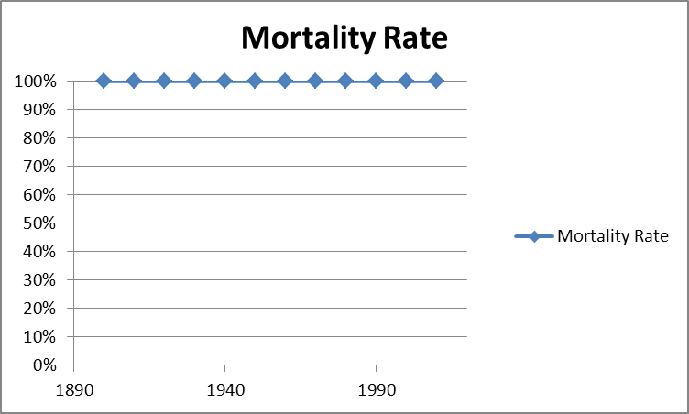
Basic Mortality statistics
Notes:
A very simple chart that illustrates a basic concept that we often forget. And that is, that we all die. It isn’t something we like to think about, but it’s true. And as I’m going to talk about, how we die is turning into a bit of train wreak in America.

Slide 11
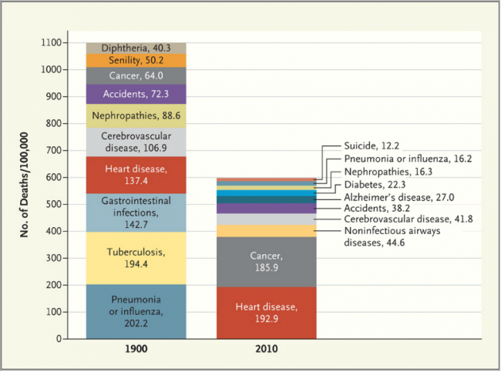
How We Die In America: A Comparison
Notes:
To illustrate just how much things have changed over the past several generations, I’d like to draw your attention to a few key points.
At the turn of the century, the main causes of death were infectious, which in general were faster deaths. Now, by and large, people are dying from such conditions, such heart disease, cancer, and chronic lung disease such as emphysema or chronic obstructive pulmonary disease. These conditions, which used to be relatively quickly fatal, have through the miracle of modern medicine become chronic diseases. My grandfather, who trained in the 1940s, used to say that medicine used to be easy; if a patient had a heart attack, you put him in a quiet room and hoped he got better! If he had a stroke, you put him I a quiet room and hoped he got better! Now, as discussed before, we have so many interventions that have turned acute diseases into chronic diseases.

Slide 12
An Ideal Life of Health
GOOD
A Typical Life
A Chronic Early Terminal Life
HEALTH
POOR
BIRTH
LIFE SPAN
DEATH

Slide 13
What Do Patients with Serious Illness Want?
Pain and symptom control
Achieve a sense of control
Relieve burdens on family
Strengthen relationships with loved ones
Avoid inappropriate prolongation of the dying process
Singer et al. JAMA 1999;281(2):163-168.

Slide 14
What Do Patients with Serious Illness Want?
To live as well as one can, for as long as one can

Slide 15
What Does it Mean to Live Well?
To remain functional and maximize independence
To be free from distressing symptoms
To continue meaningful relationships with our loved ones
To stay in our place of residence and out of the hospital
Singer et al. JAMA 1999;281(2):163-168.

Slide 16
How we Want to Die in America
At Home
In Comfort and Dignity
Being Mentally Aware
Not a Burden
With an Overall De-escalation of Medical Care
In a state of Transcendence
Notes:
A great deal of literature has been done, trying to define what a “good death” is. It will come as no surprise that there is a great deal of variation across ages, cultures, and geographic areas.
Karen Steinhauser has done a great deal of work looking at Americans and what a good death looks like. From this information we can draw some broad themes, many of which won’t be surprising:
Majority of people wish to die at home rather than in an institution, up to 80% of Americans when asked will say they’d rather die at home than in the hospital.
Comfort: No surprise here, people say they want to die comfortably without a high symptom burden. Free from pain, from anxiety.
Being mentally aware, aware and able to interact with your surroundings and loved ones
Not a burden: Many people closely link being independent with dignity, so being able to care for ones self and not be a burden to loved ones is important for the majority of americans
Transcendence: This is a tricky concept that Steinhauser uses, but this gets at the hope that many of us have, that when we die we do so in a state of acceptence and closure with our EOL, rather than in a state of existential distress.

Slide 17

How We Really Approach our
End of Life
Majority of older adults express a preference for overall de-escalation of care at the end-of-life
  Despite this, in Medicare patients, more than 25% of health care expenditures occur in the last year of life
    Of that 25%, 80% occurs in the last month
  20% of deaths in the US occur in the ICU; of these, the majority of >65
Having an advance directive or a documented conversation about goals of care decreases the likelihood of dying in a hospital and improves concordance between treatment preferences and the treatment received.
Notes:
NEED DATA SHOWING THAT GOALS OF CARE DISCUSSIONS REDUCE THIS DISCREPENCY.
So, there exists this discrepency between the desire for overall de-escalation of care at the EOL and the fact that many americans experience an increase in medical care at the EOL. Thoughtful goals of care and advanced planning discussions are an important way that this discrepency can be reduced.

Slide 18
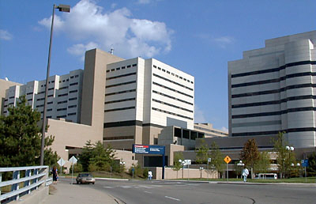
Where we Die
Notes:
Acute Care Hospitals remain the most likely place a person will die. Despite the fact that most Americans aren’t dying suddenly, despite the fact that for the majority of Americans, death comes after a long and protracted phase characterized by increased medical care and medical spending, most american’s aren’t dying where they want to.

Slide 19
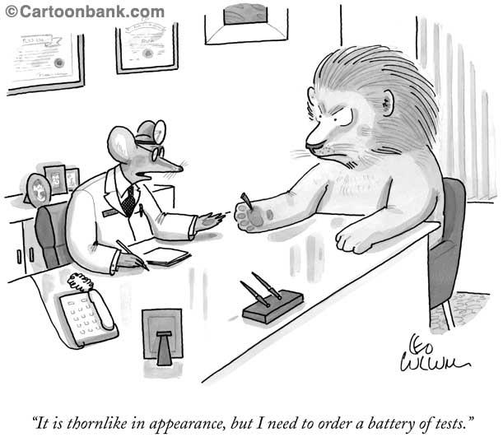
Is More Care Better Care?

Slide 20
Does Higher Spending Improve Outcomes?
More is Less and Less is More
Higher spending does not lead to better outcomes.
Medicare claims data for 4.7 million beneficiaries and 4,300 hospitals:
Dramatic geographic differences in health care costs
Regions of highest utilization (most specialist visits, hospital days, ICU use), have highest mortality after (partial) risk adjustment.
JAMA 2006; 296:159-160.
www.dartmouthatlas.com/atlases/2006_chronic_care_atlas.pdf
ES Fisher et al Health Affairs 2004; suppl web exclusive: VAR 19-32.
ES Fisher et al. Annals Intern Med 2003; 138:288-98.

Slide 21
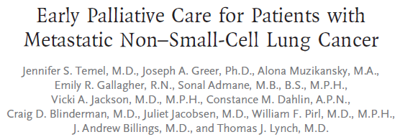
Less Medical Care and the Impact on Survival
Notes:
I told you I wasn’t going to talk much about specific studies, but this is one exception because it’s important when we think about palliative medicine and how we care for people with advanced disease. This was a study that came out in 2010, and was impressive for several reasons.

Slide 22
Less is More: Impact on Survival
151 patients with a new diagnosis of stage IV, metastatic lung cancer
  Has an average life-expectancy of 9-12 months
At the time of diagnosis, the patient was either randomized to receive counseling about goal of care integrated into standard cancer care (which can include chemotherapy or radiation) or standard cancer care alone
Temel et al NEJM 2012 (13); 145-152

Slide 23
Less is More: Impact on Survival
The group that had goals of care discussions integrated into their standard cancer care
  Had less symptoms
  Reported higher quality of life
  Were more likely to have had a discussion about their preferences for end-of-life care
  Received less aggressive care
  Lived almost three months longer
  Temel et al NEJM 2012 (13); 145-152
Notes:
LET ME SAY THAT AGAIN. Palliative care meant that people with one of the worst cancers possible lived better, lived longer, and all with LESS MEDICAL CARE. Remember when I told you that more medical care isn’t always better? This is it! This highlights a dark fact about medical care: for some people, especially those with advanced disease, aggressive medical care can shorten your life rather than lengthen it. This is what we sometimes have a hard time grasping.

Slide 24
More Care is Not Better Care
Quill et al, JPM 2009
Notes:
This study done in 2009 looked at the cost of heath care in the last week of life among cancer patients. They surveyed family members about the perceived quality of death, asking a wide variety of questions such as “did your loved one seem in pain in the final days of their life” or “was your loved-one’s death peaceful” etc.
What they found was fairly remarkable, that increased cost of care was associated with the perception of LOWER quality of death. Now, this needs to be taken with a grain of salt, in that we can’t ask the patients what their perception was; but the point is that spending more money at the EOL is not necessarily a/w a better or more peaceful dying experience, and quite the opposite may be associated with more distress and more suffering.

Slide 25

Advance Care Planning

Slide 26
So What Can I Do?
Advance Care Planning: What Is It?
  Designate a Durable Power of Attorney (DPOA)
  Document preferences for life sustaining treatment and resuscitation (Living Will)

Slide 27
Advance Care Planning:
How it helps
Adults who have completed an advance directive or who have documented conversations about preferences for care at the end of life:
  Are less likely to die in the hospital
  Are less likely to receive aggressive treatment at the end of life
  Are more likely to receive treatment in concordance with their wishes
  Families are more likely to report support in decision making
Notes:
NEED DATA SHOWING THAT GOALS OF CARE DISCUSSIONS REDUCE THIS DISCREPENCY.
So, there exists this discrepency between the desire for overall de-escalation of care at the EOL and the fact that many americans experience an increase in medical care at the EOL. Thoughtful goals of care and advanced planning discussions are an important way that this discrepency can be reduced.

Slide 28
Durable Power of Attorney
“If I get so sick I can’t make decisions for myself, who would make decisions for me?”

Slide 29
Advance Directives
Living Will: “If I get so sick I can’t speak for myself, what should my DPOA know about me and my preferences to make decisions for me?”
  What aspects of my QUALITY of life am I willing to sacrifice so I can live longer?
  Are there specific types of treatment that I do or do not want?
  If get so sick it looks like I’m dying, what do I want that to look like?

Slide 30
Treatment Based Decisions
“Do you want a feeding tube or not?”
“Do you want dialysis or not?”
“Do you want chemotherapy, or do you want to die?”

Slide 31

Value-Based Decision Making
Where the question isn’t “do I want this treatment or not” but rather…
“what are my goals for the future, and will a proposed treatment get me closer to (or farther away) from those goals?”

Slide 32
Value-Based Decision Making
Examples of values impacting decision making:
Independence/Place of residence
Cognitive State
Physical suffering
Terminal State

Slide 33
Having the Conversation

Slide 34
How to Start the Conversation
Step 1: Plan Ahead
  What do we need to talk about?
    Medical Decision making
    Finances
    Making sure a family member is taken care of
  Who needs to be there?
    Spouse, children, friend, doctor, attorney?

Slide 35
How to Start the Conversation
Step 1: Plan Ahead (cont)
  When is a good time to talk?
    Next family gathering
    Before the next surgery
    After a doctor’s appointment
  Where will you feel comfortable talking?
    Kitchen table
    Favorite Restaurant
    In the Car
    Place of Worship

Slide 36
How to Have the Conversation
Step 2: Break the Ice
  “I need to think about the future. Will you help me?”
  “Even though I’m ok right now, I’m won’t always be, and I want to be prepared”
  “Do you remember when (friend/family member) died? Was it a good death or a hard death? How would you want your death to be different?”
  “If there ever comes a time when you can’t talk for yourself, there are some things I need to know. Is it ok if we talk about that now?”

Slide 37
How to Have the Conversation
Step 3: Discuss the important things
  “When you think about your health, what worries you?”
  “If you got so sick it looked like you were getting close to your end of life, what would you want your care to look like?”
  “What affairs (personal, financial etc) would you want to get in order if you got sick and it didn’t look like you could get better?”
  “Would you want to be actively involved in making medical decisions, or would you rather have your doctors do what they thought was best?”

Slide 38
How to Have the Conversation
Step 3: Discuss the important things (cont)
  “Who do you want (or not want) to be involved in your care?”
  “If you got so sick you couldn’t speak for yourself, who would you want to make decisions for yourself?”
  “When would it be ok to shift the focus from aggressive, curative care to a focus on comfort care alone?”

Slide 39
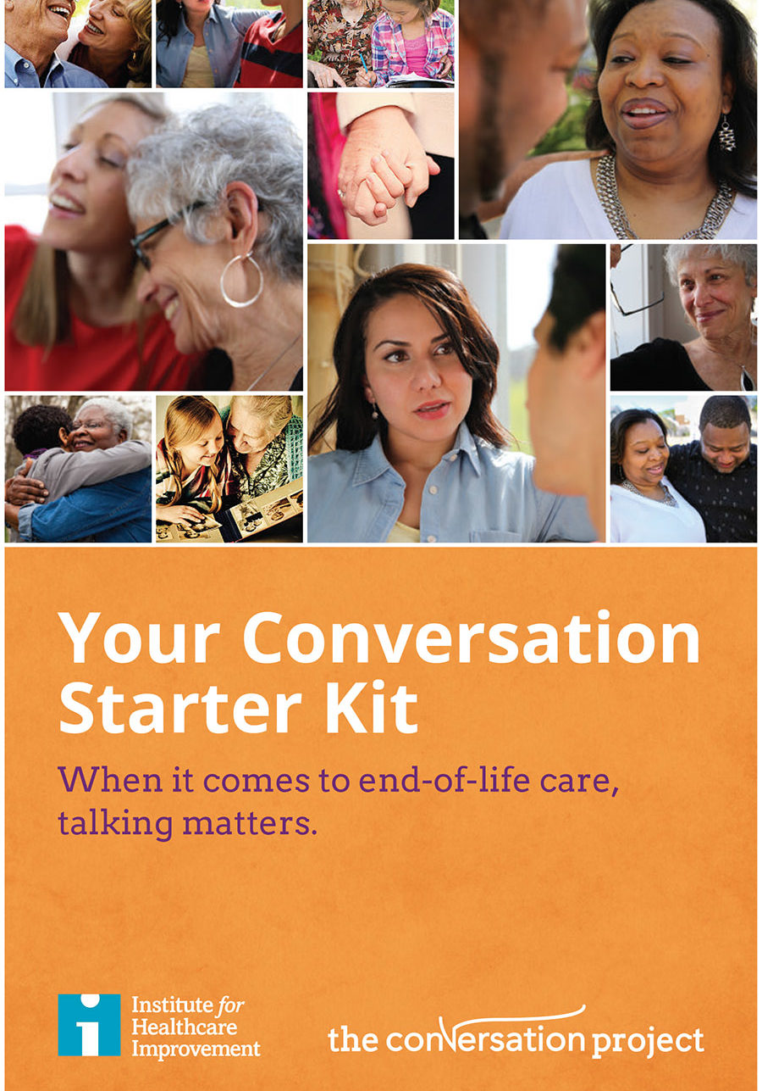
www.theconversationproject.org

Slide 40
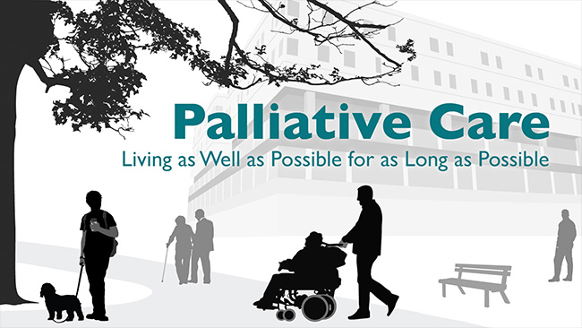
Palliative Care

Slide 41
Palliative Care: A Definition
The goal of palliative care is to prevent and relieve suffering….Palliative care is accomplished through effective management of pain and other distressing symptoms, while incorporating psychosocial and spiritual care according to patient/family needs, values, beliefs, and culture(s).
Clinical Practice Guidelines for Quality Palliative Care, National Consensus Project
Notes:
This bring us to the role of palliative care in american medicine, which I’ll be talking about first to contrast with HOSPICE care. What is palliative care? Broadly speaking, palliative care is any care that seeks to alleviate the symptoms of a disease rather than cure the disease itself. We do this all the time. If you have a sore throat and you doctor tells you to take tylenol, they’re practicing palliative care; the tylenol won’t help your throat heal faster, but it WILL make it hurt less.
More specifically, when we use the term palliative care as it relates to the American medical system, we’re referring to a philosophy of care that focuses on the effective management of the symptoms a disease causes rather that the disease itself. The field of palliative medicine, as a core tenent, also recognizes that a chronic or life-threatening illness had psychosocial, cultural, and spiritual components rather than just physical.

Slide 42
Palliative Care: But what does that mean?
Palliative Care focuses on the person rather than the disease:
  Focus on symptom control (pain, nausea, fatigue, shortness of breath) caused by a chronic disease
  Focus on quality of life, and recognizes that “quality of life” means different things for different people
Notes:
Why is this important? As we said before, the modern medical system is such it is allowing us to live longer with incurable disease. Many major medical disease can’t be cured, they can only be managed; Congestive heart failure, emphysema, dementia. We’re living with disease longer, and palliative care can help people live better with advanced disease.
What does that mean? For a lot of our patients who are chronically ill, the risk of continued aggressive medical care may outweight the benefits; as I’ll talk about soon, we have data showing that more aggressive medical care, rather than lengthening your life, can shorten it AND decrease the quality.

Slide 43
Palliative Care: But what does that mean?
Palliative Care focuses on the person rather than the disease:
  Recognizes that chronic medical conditions not only have physical components, but also psychosocial, cultural, emotional, and spiritual aspects that effect the individual
  Focus on effective communication about goals of care, risks/benefits of treatments proposed, and advanced care planning
Notes:
Why is this important? As we said before, the modern medical system is such it is allowing us to live longer with incurable disease. Many major medical disease can’t be cured, they can only be managed; Congestive heart failure, emphysema, dementia. We’re living with disease longer, and palliative care can help people live better with advanced disease.
What does that mean? For a lot of our patients who are chronically ill, the risk of continued aggressive medical care may outweight the benefits; as I’ll talk about soon, we have data showing that more aggressive medical care, rather than lengthening your life, can shorten it AND decrease the quality.

Slide 44
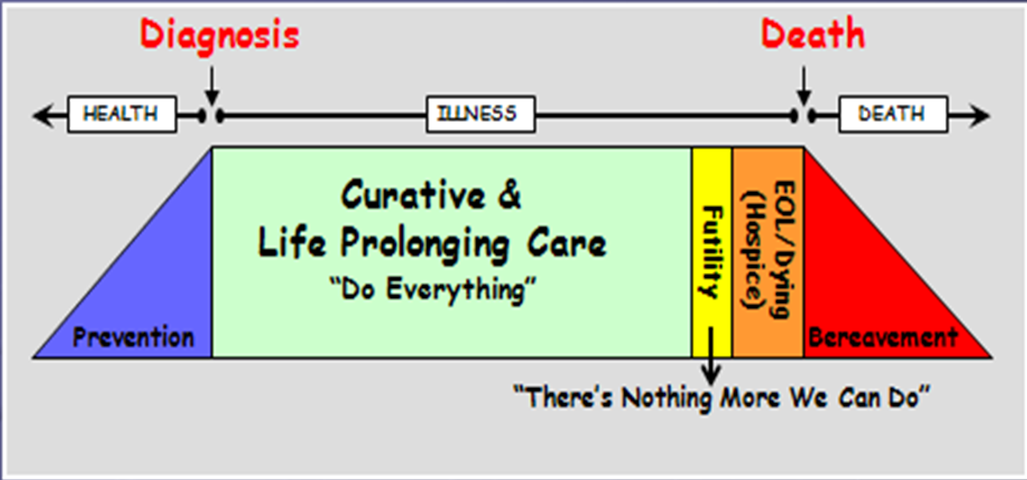
Traditional Model of Medicine
Notes:
The traditional model of care, where the focus is curative curative curative until a disease enters the terminal phase at which hospice is brought on board (which we’ll talk about soon).

Slide 45
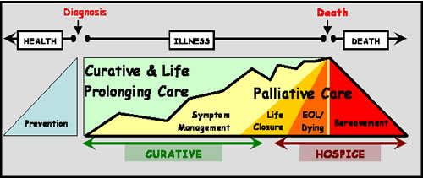
Proposed Integration of Palliative Care
Notes:
This is the more advance model, which is a lot busier, but I want to point out that from the beginning of a chronic disease, pallative care with a focus on symptom management should be incorporated into a plan of care. As the disease becomes more advanced, the palliative care team can start discussions about goals of care, and help the patient make informed decisions about what care will help them reach their goals and what won’t; is that 10th round of chemotherapy something a patient wants? Is the 15th heart surgery really appropriate?

Slide 46
Palliative Care: Sounds great, but does it work?
Attains Several Goals:
  Reduces in symptom burden for patients living this advanced disease
  Keeps patients where they want to be (at home)
  Reduces Costs
Notes:
First off, what do you mean by “work?” Maybe you mean, does palliative care does what we think it does, does it reduce the suffering associated with chronic disease? Or, you know, I spent a lot of time talking about the perceived quality of care delieved, so does palliative care improve patient or family satisfaction with the care they receive? Or maybe you’re thinking to yourself “it sounds nice, but in this day and age of sky-rocketing health care costs, does palliative care add to or take away from the price tag of the American Medical System?”
The answer is yes to all three, which I’ll explain. For the sake of time, I’m going to be avoiding going into details on the clinical studies that have proven these points; if anyone is interested, I’m happy to talk afterwards about the specific studies involved.

Slide 47
Palliative Care Reduces Symptoms
For those patients living with advanced disease (cancer, heart failure, kidney disease, emphysema), palliative care is superior to usual care for:
  Emotional/Spiritual Support
  Pain control
  Information/Communication
  Care at the time of death
  Access to services in the community
  Well-being/dignity

Slide 48
When to ask for Palliative Care
There are uncontrolled physical symptoms related to a serious illness, or its treatment
A person or their family is experiencing emotional or spiritual distress regarding the diagnosis/prognosis
Intra-family or family-physician conflict about goals of care or advanced care planning
Accelerating need for medical care or hospitalizations
A person has declined or are considering declining life-sustaining treatments, i.e. feeding tube or tracheostomy
Notes:
Sx: Pain, muscle spams; in those patients with FTD, hallucinations, behaviors, etc
The need for psychosocial support
48

Slide 49
Palliative Care Delivery Modes
Hospitals
  Consultative Services
  Inpatient Units
Outpatient Clinics
Home-based Palliative Care
  Private Residential Services
  Nursing Homes/ Long Term Care
Hospice
Notes:
Sx: Pain, muscle spams; in those patients with FTD, hallucinations, behaviors, etc
The need for psychosocial support
49

Slide 50
Palliative Care Services at UMHS
UMHS Inpatient Palliative Consult Service
Palliative and Supportive Care Clinic
  East Ann Arbor, in the Turner Geriatric Center
  Chelsea Family Practice
  Livonia Family Practice
UM Cancer Center Symptom Management and Supportive Care Clinic
UM Cardiovascular Center Palliative and Supportive Care Clinic
Notes:
50

Slide 51
Where Can I Get Information About
Palliative Care?
GetPalliativeCare.Org
Notes:
Sx: Pain, muscle spams; in those patients with FTD, hallucinations, behaviors, etc
The need for psychosocial support
51

Slide 52
In Conclusion
American are living longer, with more disease than ever before
The current health care system is providing many with care that is neither beneficial nor desired. MORE CARE IS NOT BETTER CARE
Advance care planning is a means by which an individual can plan for the future to ensure their wishes for health care are followed

Slide 53
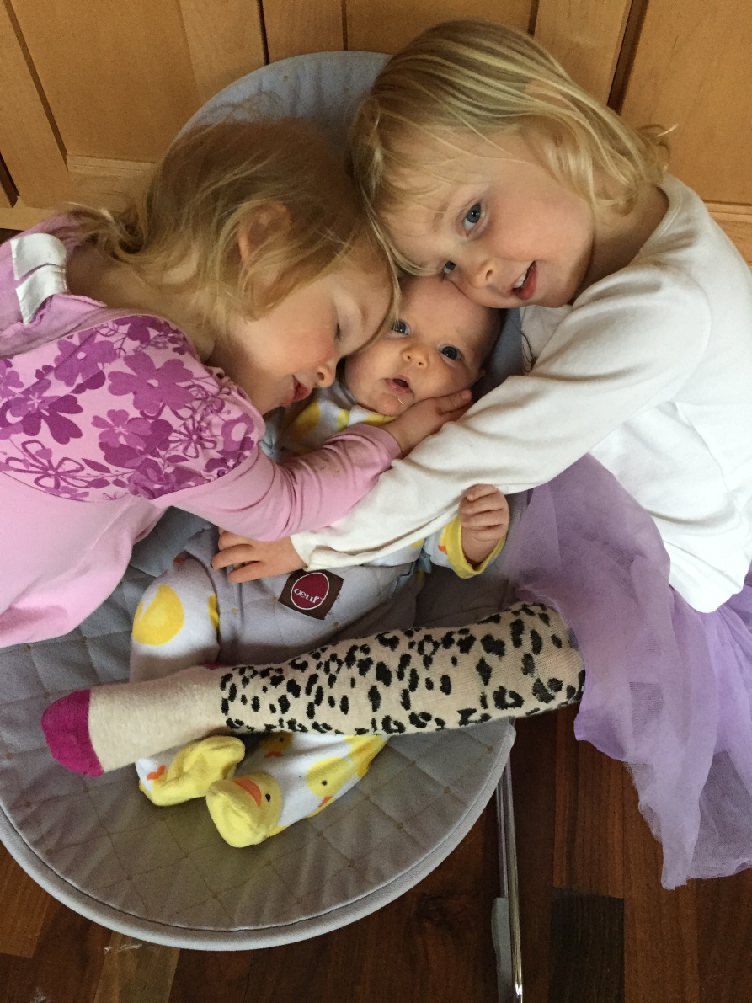
Questions?

